Slide 1


MEET YOUR GOVERNORS/PTFA

Slide 2
Who are our Governors?
NAME | POSITION & RESPONSIBILITIES | Class Link
Mrs Youngblood/ Mr Shrimplin | Staff Governors | -
Rob Fryer (Co-opted) | Chair of FGB Safeguarding incl. monitoring and filtering/ Attendance | Y2
Kate McLeod (Co-opted) | Vice Chair of FGB Finance/SFVS/ /Chair of FWG /HT performance | EYFS/Y1
Luke Hamm (Parent Gov) | FWG/Science/Comms/Wellbeing/ School Council | Y6
Chris Leyland (Parent Gov) | English (Writing/Spelling) English (Reading/Phonics) | Y4
Christian Howe (Co-opted) | P.E / Premises and H&S/ Pay & personnel committee | Y3
Joseph Fielder (Co-opted) | Maths, SEND (inclusion/disadvantage (PP) | Y5

Slide 3

Governors
What School Governors Do
School governors are volunteers who help make sure a primary school is well-run, safe and supports every child’s learning.
They don’t manage the school day-to-day—but they provide guidance, oversight, and challenge where needed.

Slide 4

How Governors Support Your Child’s School
1. Keep the School on the Right Track
They help set the school’s priorities—like improving learning, behaviour, or wellbeing—and make sure the school is working towards them.
2. Check Children Are Learning Well
Governors look at how pupils are doing, ask questions about progress and make sure the school is offering a strong curriculum.
3. Oversee the School Budget
They help decide how money is spent so children have good teachers, resources and a safe environment.

Slide 5

4. Support the Headteacher and Staff
Governors work with the headteacher on big decisions and help make sure staff have the training and support they need.
5. Make Sure Children Are Safe
They check that safeguarding, behaviour, and health & safety procedures are strong and up to date.
6. Represent Parents and the Community
Governors listen to families’ views and help make sure the school meets the needs of its community.

Slide 6
Why It Matters for Your Child
Because of governors, schools stay focused on:
high quality teaching
high expectations
safety and wellbeing
using resources wisely
continuous improvement
Governors help make sure the school stays accountable and ambitious for every child.

Slide 7

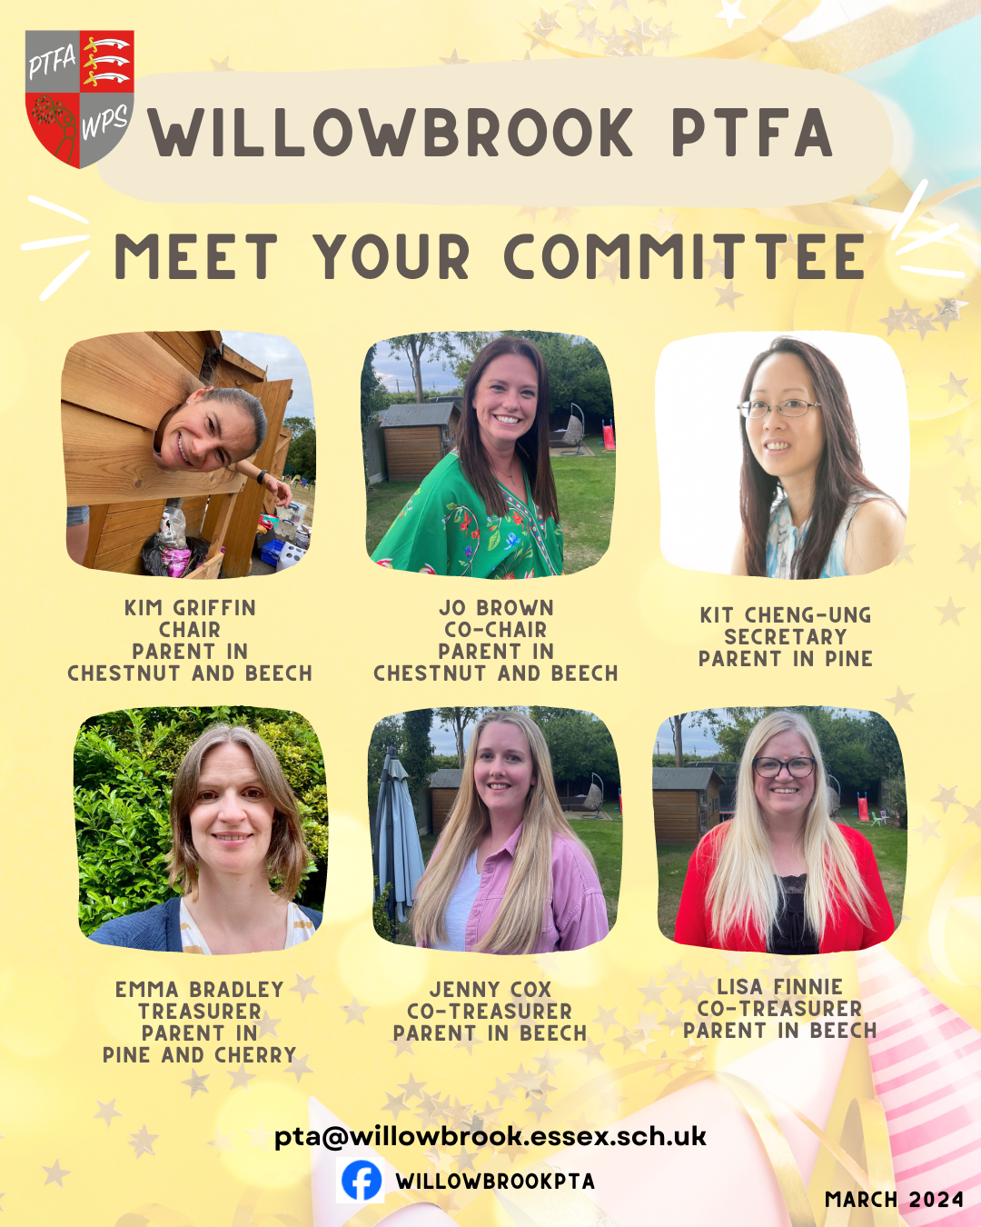
Willowbrook Primary School – PTFA
(Parent, Teacher, Friends Association)
Our mission is:
“To make the school a better place for our children to learn,
have fun and aid the school to provide a great education”
We are a committee of 6 and are all trustees
Registered Charity: 1046576
Important to build a strong community feel between school, parents, and local community.
The PTFA doesn’t function without volunteers – they play important role in fundraising and coming up with ideas, and supporting at our events.
Termly newsletter - ‘The Willow’. Updates on events, monies raised and invested and general information.
Volunteering comes in many forms, the bits that happen in person but also in the form of support from your workplaces and networks. Sponsorship for items or even match funding is greatly appreciated.
It all helps to keep us funding the school with resources, trips and general fun educational stuff!

Slide 8
Winter Disco
raised
£400
Christmas Raffle raised
£413
Asda Rewards
raised
£225
Christmas Raffle raised
£413
Salesforce**
raised
£176
Fantasy Football
raised
£170
Colour Run
raised
£700
St Patricks Quiz
raised
£300
What we raised in 2024/2025
Christmas Raffle raised
£413
Christmas Raffle raised
£413
Pre-Loved Uniform
raised
£105
Christmas Cards & Gifts
raised
£130
Summer Disco
raised
£400
Summer Fayre
raised
£3,400
My School Lottery
raised
£519
Groundwork
(Tesco Tokens)
raised
£800
**Parent Company donation

Slide 9
Year 6 – MAD Day
£750
Oranges for Christingle Workshop
£45
Contribution for coaches to panto
£1100
Snacks & Drinks for Panto
£60
Sports Day
£85
Fathers Day Breakfast
£250
Class Budget Treats
What we raised in 2024/2025
Science Day
(Animal Encounters)
£439
Year 6 Leavers Gifts
£300
Mothers Day Afternoon
Tea Cake Donations
How we invested monies raised
Easter Bunny & Treat
£127
Coffee Morning Supplies
Santa Visit & Treat
£350
New Rugs – Infants
£827*
Storage Boxes (playground)
£785
Holly Class Trip
£238
Eco Area Supplies
£300
Library Seating*
£384
Class Budget Treats
£310
*Funded from Coop Well-being grant

Slide 10



